Slide 1
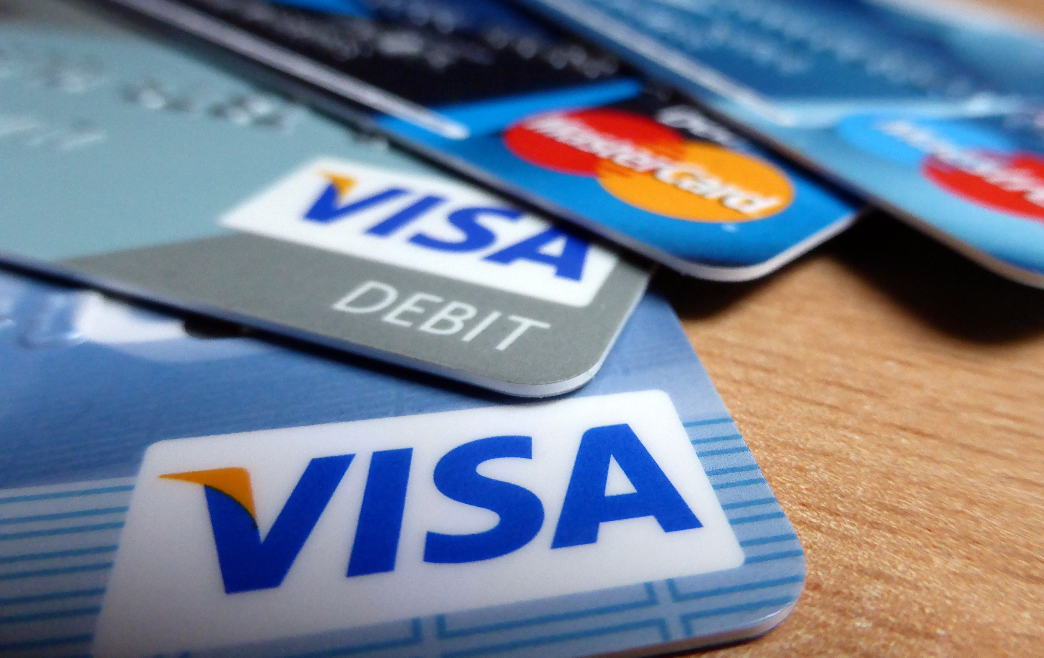
Coerced Debt
Women’s Spirit, Tel Aviv
Angie Littwin, J.D.
University of Texas School of Law
Adrienne E. Adams, Ph.D.
Michigan State University

Slide 2
U.S
Background
Defining Coerced Debt
Effects of Coerced Debt
Discussion

Slide 3
U.S
Background
Defining Coerced Debt
Effects of Coerced Debt
Discussion

Slide 4
1 in 4 women are physically assaulted by an intimate partner annually
Thjaden & Thoennes, 2000
Notes:
Physical violence is just one component of the violence many women experience in their relationship.

Slide 5
Intimate Partner Abuse is…
“
a pattern of abusive behavior used by one partner to gain or maintain power and control over another intimate partner
”
US Department of Justice, 2012
Notes:
Overwhelmingly, this form of abuse is committed by men against their female partners

Slide 6
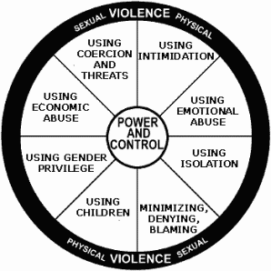

Slide 7
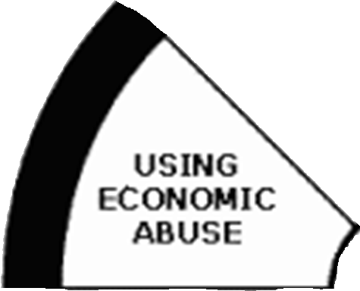

Slide 8
Economic Abuse is…
“
when batterers control victims’ finances to prevent them from accessing resources, working or maintaining control of earnings, achieving self-sufficiency, and gaining financial independence.
”
National Coalition Against Domestic Violence

Slide 9
Psychological
100%
Adams, Sullivan, Bybee, & Greeson, 2008
Notes:
Economic abuse is as common as other forms of abuse…

Slide 10
Psychological
100%
Physical
98%
Adams, Sullivan, Bybee, & Greeson, 2008
Notes:
Economic abuse is as common as other forms of abuse…

Slide 11
Psychological
100%
Economic
99%
Physical
98%
Adams, Sullivan, Bybee, & Greeson, 2008
Notes:
Economic abuse is as common as other forms of abuse…

Slide 12
Financial Control
Financial Exploitation
Notes:
Two components: financial restriction and financial exploitation

Slide 13
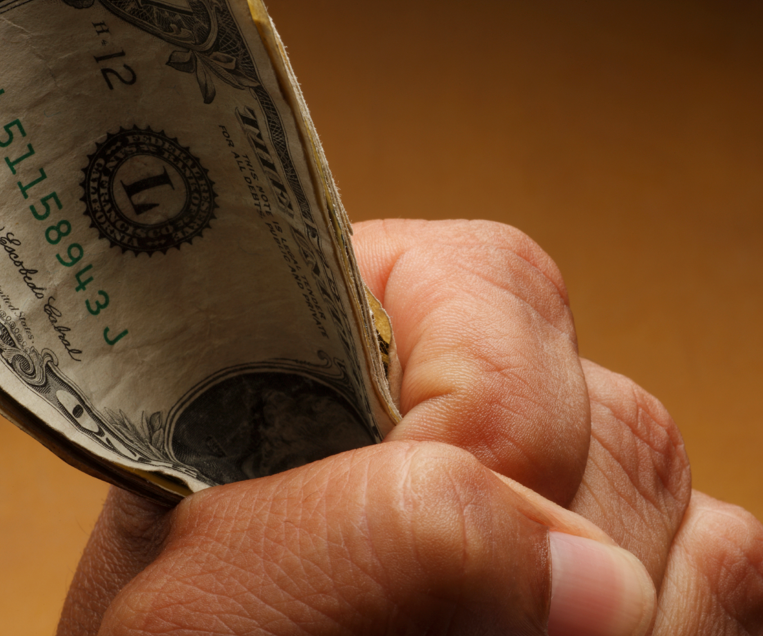
Financial Control
Restricting access to or use of resources
Restricting income generation
Restricting use of money or property
Restricting access to financial information

Slide 14
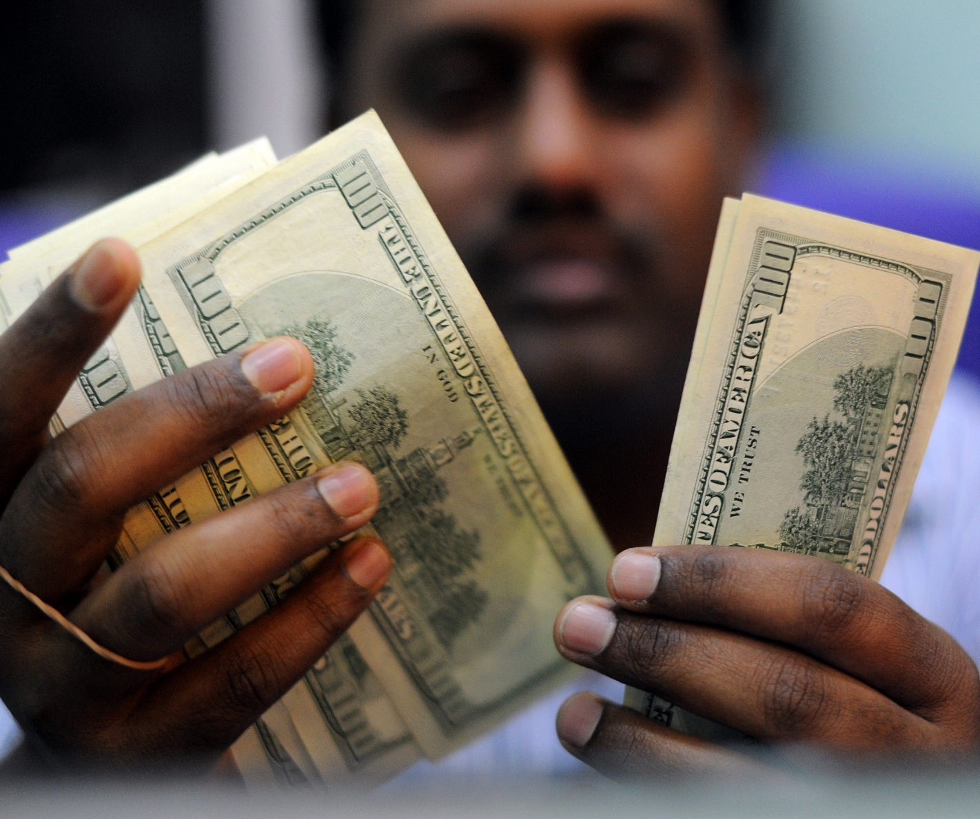
Unfairly using resources for one’s own advantage
Spending money
Stealing money or property
Generating debt
Financial Exploitation

Slide 15
Unfairly using resources for one’s own advantage
Spending money
Stealing money or property
Generating debt
Financial Exploitation

Slide 16
Our Research
Development of the Scale of Economic Abuse (Adams, et al, 2008)
Study of DV Professionals (Littwin, 2012)
In-depth interviews with coerced debt survivors (Adams & Littwin, in progress)
National Domestic Violence Hotline Survey (Adams & Littwin, in progress)

Slide 17
National DV Hotline Survey
10 questions about coerced debt and its effects
Administered by hotline staff
1816 English-speaking female callers over age 18

Slide 18
National DV Hotline Survey
Participant Age

Slide 19
National DV Hotline Survey

Slide 20
Defining Coerced Debt
Background
Addressing Coerced Debt
Identifying Coerced Debt
Notes:
START

Slide 21
Coerced Debt is…
“
any non-consensual credit-related transaction that occurs within an abusive intimate relationship
”
Littwin, 2012

Slide 22
Coercive Control
DEMANDS
THREATS
Leaving the house
Eating
Sleeping
Wearing certain clothes
Using TV, radio, internet
Bathing; using the restroom
Using the phone
Spending time with others
Taking care of kids
Buying and preparing food
Working; earning money
Spending money
Using vehicle
Using credit cards
Say something mean
Say something humiliating
Tell others private info
Keep from seeing people
Keep from leaving home
Physically harm
Leave the relationship
Cause to lose kids
Cause legal trouble
Keep from taking meds
Cause to lose housing
Keep from working
Keep from having money
Dutton, Goodman, & Schmidt, 2006
Notes:
[something like this] We use the term “coerced debt” because it is debt generated within the context of coercive control. Abusers maintain power in the relationship by placing demands on their partner and enforcing those demands through the use of threats and surveillance (Goodman & Dutton). In other words, abusers dictate their partner’s behavior through explicit or tacit threats of harm to themselves or others for non-compliance with their demands. They make demands about all kinds of things: what she can wear, who she can see, when she can leave the house, what she cooks, or how she cares for the kids. They enforce those demands with all kinds of threats, from saying something mean to physically hurting them or someone they love.
There are three ways coercive control is used to hurt women financially: 1) abusers use coercion to dictate financial behavior, e.g., hand over your paycheck or else; use your credit card to buy me that TV or else; 2) financial harm can result from non-compliance with other demands, e.g., not giving her money for food because she did not cook the right thing for dinner; put a cell phone in her name because she was out with her friends too late 3) the perpetual, tacit threat of harm prevents her from taking action when his behavior threatens her financial well-being, e.g., does or says nothing when he spends all the money on entertainment for himself, keeps her from seeing any of the bills, or takes out a loan in her name. These conditions, the conditions of coercive control, lay the groundwork for coerced debt.

Slide 23
Coercive Control
DEMANDS
THREATS
Leaving the house
Eating
Sleeping
Wearing certain clothes
Using TV, radio, internet
Bathing; using the restroom
Using the phone
Spending time with others
Taking care of kids
Buying and preparing food
Working; earning money
Spending money
Using vehicle
Using credit cards
Say something mean
Say something humiliating
Tell others private info
Keep from seeing people
Keep from leaving home
Physically harm
Leave the relationship
Cause to lose kids
Cause legal trouble
Keep from taking meds
Cause to lose housing
Keep from working
Keep from having money
Dutton, Goodman, & Schmidt, 2006
Notes:
[something like this] We use the term “coerced debt” because it is debt generated within the context of coercive control. Abusers maintain power in the relationship by placing demands on their partner and enforcing those demands through the use of threats and surveillance (Goodman & Dutton). In other words, abusers dictate their partner’s behavior through explicit or tacit threats of harm to themselves or others for non-compliance with their demands. They make demands about all kinds of things: what she can wear, who she can see, when she can leave the house, what she cooks, or how she cares for the kids. They enforce those demands with all kinds of threats, from saying something mean to physically hurting them or someone they love.
There are three ways coercive control is used to hurt women financially: 1) abusers use coercion to dictate financial behavior, e.g., hand over your paycheck or else; use your credit card to buy me that TV or else; 2) financial harm can result from non-compliance with other demands, e.g., not giving her money for food because she did not cook the right thing for dinner; put a cell phone in her name because she was out with her friends too late 3) the perpetual, tacit threat of harm prevents her from taking action when his behavior threatens her financial well-being, e.g., does or says nothing when he spends all the money on entertainment for himself, keeps her from seeing any of the bills, or takes out a loan in her name. These conditions, the conditions of coercive control, lay the groundwork for coerced debt.

Slide 24
Coercive Control
DEMANDS
THREATS
Leaving the house
Eating
Sleeping
Wearing certain clothes
Using TV, radio, internet
Bathing; using the restroom
Using the phone
Spending time with others
Taking care of kids
Buying and preparing food
Working; earning money
Spending money
Using vehicle
Using credit cards
Say something mean
Say something humiliating
Tell others private info
Keep from seeing people
Keep from leaving home
Physically harm
Leave the relationship
Cause to lose kids
Cause legal trouble
Keep from taking meds
Cause to lose housing
Keep from working
Keep from having money
Dutton, Goodman, & Schmidt, 2006
Notes:
[something like this] We use the term “coerced debt” because it is debt generated within the context of coercive control. Abusers maintain power in the relationship by placing demands on their partner and enforcing those demands through the use of threats and surveillance (Goodman & Dutton). In other words, abusers dictate their partner’s behavior through explicit or tacit threats of harm to themselves or others for non-compliance with their demands. They make demands about all kinds of things: what she can wear, who she can see, when she can leave the house, what she cooks, or how she cares for the kids. They enforce those demands with all kinds of threats, from saying something mean to physically hurting them or someone they love.
There are three ways coercive control is used to hurt women financially: 1) abusers use coercion to dictate financial behavior, e.g., hand over your paycheck or else; use your credit card to buy me that TV or else; 2) financial harm can result from non-compliance with other demands, e.g., not giving her money for food because she did not cook the right thing for dinner; put a cell phone in her name because she was out with her friends too late 3) the perpetual, tacit threat of harm prevents her from taking action when his behavior threatens her financial well-being, e.g., does or says nothing when he spends all the money on entertainment for himself, keeps her from seeing any of the bills, or takes out a loan in her name. These conditions, the conditions of coercive control, lay the groundwork for coerced debt.

Slide 25
Coercive Control
DEMANDS
THREATS
Leaving the house
Eating
Sleeping
Wearing certain clothes
Using TV, radio, internet
Bathing; using the restroom
Using the phone
Spending time with others
Taking care of kids
Buying and preparing food
Working; earning money
Spending money
Using vehicle
Using credit cards
Say something mean
Say something humiliating
Tell others private info
Keep from seeing people
Keep from leaving home
Physically harm
Leave the relationship
Cause to lose kids
Cause legal trouble
Keep from taking meds
Cause to lose housing
Keep from working
Keep from having money
Dutton, Goodman, & Schmidt, 2006
Notes:
[something like this] We use the term “coerced debt” because it is debt generated within the context of coercive control. Abusers maintain power in the relationship by placing demands on their partner and enforcing those demands through the use of threats and surveillance (Goodman & Dutton). In other words, abusers dictate their partner’s behavior through explicit or tacit threats of harm to themselves or others for non-compliance with their demands. They make demands about all kinds of things: what she can wear, who she can see, when she can leave the house, what she cooks, or how she cares for the kids. They enforce those demands with all kinds of threats, from saying something mean to physically hurting them or someone they love.
There are three ways coercive control is used to hurt women financially: 1) abusers use coercion to dictate financial behavior, e.g., hand over your paycheck or else; use your credit card to buy me that TV or else; 2) financial harm can result from non-compliance with other demands, e.g., not giving her money for food because she did not cook the right thing for dinner; put a cell phone in her name because she was out with her friends too late 3) the perpetual, tacit threat of harm prevents her from taking action when his behavior threatens her financial well-being, e.g., does or says nothing when he spends all the money on entertainment for himself, keeps her from seeing any of the bills, or takes out a loan in her name. These conditions, the conditions of coercive control, lay the groundwork for coerced debt.

Slide 26
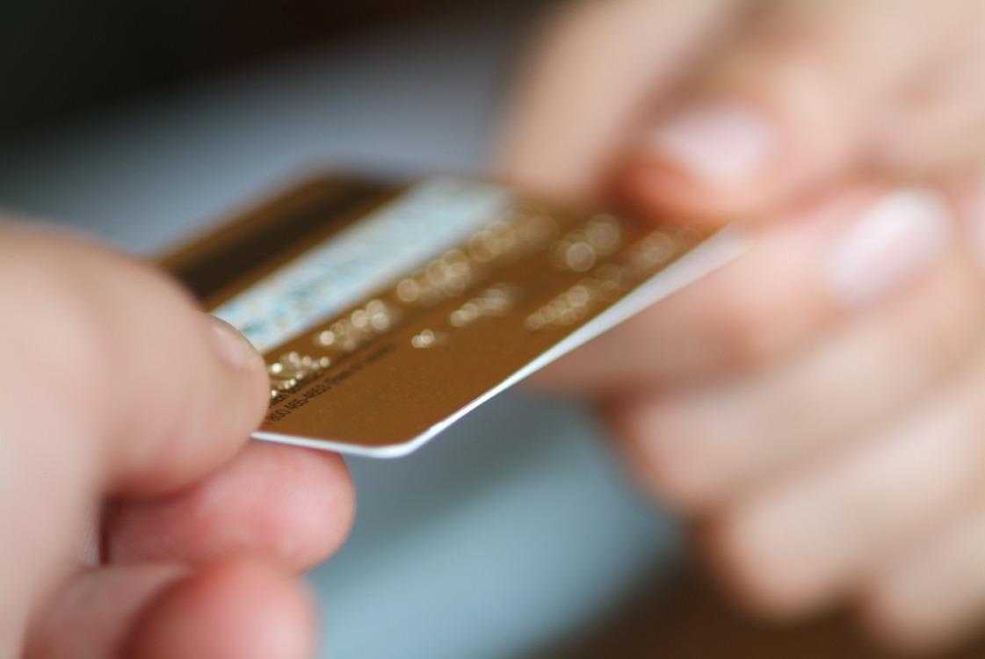
Obtaining credit in a partner’s name (mortgage, student loans, personal loans, car loans, credit cards, payday loans)

Slide 27
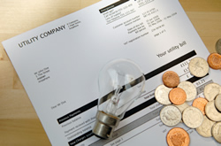
Obtaining credit in a partner’s name (mortgage, student loans, personal loans, car loans, credit cards, payday loans)
Putting bills in a partner’s name (utilities, phone, cable, rent)

Slide 28
Obtaining credit in a partner’s name (mortgage, student loans, personal loans, car loans, credit cards, payday loans)
Putting bills in a partner’s name (utilities, phone, cable, rent)
Coerced Debt

Slide 29
3 Mechanisms of Coerced Debt
3 Mechanisms of Coerced Debt
Fraud
Using the survivor’s identity without their knowledge to obtain a loan or credit in her name

Slide 30
3 Mechanisms of Coerced Debt
3 Mechanisms of Coerced Debt
Fraud
Using the survivor’s identity without their knowledge to obtain a loan or credit in her name
Coercion
Using demands and threats to lead survivor to take on debt she would not have otherwise incurred

Slide 31
3 Mechanisms of Coerced Debt
Fraud
Using the survivor’s identity without their knowledge to obtain a loan or credit in her name
Coercion
Using demands and threats to lead survivor to take on debt she would not have otherwise incurred
Deliberately managing conditions or information to lead survivor to take on debt she would not have otherwise incurred
Manipulation

Slide 32
Fraud
Have you ever found out about debt or bills you owed that an intimate partner put in your name without you knowing?
22%
n = 1748
Adams & Littwin, in progress

Slide 33
Fraud Discovery
% | Method
63 | Creditor or bill collector contact
9 | Reviewing credit report
8 | Applying for a new loan or service
7 | Friend, family member, police, bank staff
5 | Seeing it on a bank or credit statement
3 | Abuser confession
3 | Economic loss – garnishment or repo
3 | Divorce process

Slide 34
Fraud Discovery
63 % | Creditor or bill collector contact
67%
24%

Slide 35
Coercion
Has an intimate partner ever convinced or pressured you to borrow money or buy something on credit when you didn’t want to? AND threat of consequence for saying “no?”
43%
n = 1592
Adams & Littwin, in progress

Slide 36
Coercion
Has an intimate partner ever convinced or pressured you to borrow money or buy something on credit when you didn’t want to? AND threat of consequence for saying “no?”
Type of Threat
Financial
43%
Physical
Psychological
Adams & Littwin, in progress

Slide 37
Any Coerced Debt
Coercion
OR
51%
Fraud
n = 1625
Adams & Littwin, in progress

Slide 38
Any Coerced Debt
Coercion Physical harm
32%
OR
51%
Fraud
n = 1615
Adams & Littwin, in progress

Slide 39
Any Coerced Debt
Duress, U.S. law
35%
OR
51%
Fraud
n = 1652
Adams, Littwin, & Javorka (under review)
Notes:
Duress – had an RA analyze and synthesize the case law on the question of – what conduct undermines someone’s free will
Two different RAs coded participants’ answers according to the caselaw
Duress does not actually apply to coerced debt b/c the creditor is a third party that had no knowledge of the coercion and gave value
But still useful to code for the element of what undermines someone’s free will b/c useful for policy reform – and for bringing statutory “unauthorized use” cases now.
Duress broadened physical abuse by including threats like turning someone into immigration authorities, hurting pets or generally creating a climate of intimidation.
Had an additional category of “duress if there’s coercive control in the relationship” but did not include those results here.

Slide 40
Coercion (possible)
Has an intimate partner ever convinced or pressured you to put the bills under only your name? AND Were you left owing money on bills that had not been paid on time or in full?
33%
n = 1761
Adams & Littwin, in progress

Slide 41
Subtle coercion
“It was good to keep things on the ups with him, so if I could give him something that would keep him content it was a good way to be.”
Manipulation
“I was supporting both of us on a graduate student income, so I just kept charging stuff. I tried to explain to him that it just wasn’t possible, but he really thought I was hiding money, he just assumed that I was a rich American and that I had this endless supply of money, but I couldn't really convince him otherwise.”
Notes:
Here’s a couple of quotes illustrating the dynamics that resulted in tens of thousands of dollars of credit card and student loan debt.

Slide 42
Manipulation
“When I came to this country, I don’t know exactly how the loans [work], how do you apply ,and when I wanted him to explain to me he would say ‘It’s very complicated, so let me do it. Don’t worry about it. Let me handle it...” If he needed my signature, I’d sign it, because I trusted him. …He’d say ‘don’t worry, we will pay it slowly, but this is how everybody do, so just sign.’ But every time I wanted explanation he would say, it’s very complicated, so you are very, very busy, you have the baby, so just take care of the baby and let me take care of the finance. Let me take the stress off you.’ This is how he would say it. So I would never know how much I would have in credit, and I’ve been asking him many times, like how much…when I would ask him he would say “like everyone has loans, but when I would ask him how much exactly, he would say ‘that’s too much information. You don’t need it. So this is how he used to do it. He would minimize it, like it was normal. So I never had any type of information, like this [credit report]…he would take everything. He had the key to the mailbox and would take every mail, like I would not have access to the mail.”
33%
Notes:
Here’s one women’s story of coerced debt. She fell in love with an American man when he was vising her country. After some time, she moved here and got married. Not long after the physical, psychological, and economic abuse began. Here’s how some of her debt came to be.
In the end, she had $10,000 in student loan debt, much of which he spent on entertainment with his friends and thousands of dollars in unpaid rent and utilities.

Slide 43
Manipulation
“When I came to this country, I don’t know exactly how the loans [work], how do you apply ,and when I wanted him to explain to me he would say ‘It’s very complicated, so let me do it. Don’t worry about it. Let me handle it...” If he needed my signature, I’d sign it, because I trusted him. …He’d say ‘don’t worry, we will pay it slowly, but this is how everybody do, so just sign.’ But every time I wanted explanation he would say, it’s very complicated, so you are very, very busy, you have the baby, so just take care of the baby and let me take care of the finance. Let me take the stress off you.’ This is how he would say it. So I would never know how much I would have in credit, and I’ve been asking him many times, like how much…when I would ask him he would say “like everyone has loans, but when I would ask him how much exactly, he would say ‘that’s too much information. You don’t need it. So this is how he used to do it. He would minimize it, like it was normal. So I never had any type of information, like this [credit report]…he would take everything. He had the key to the mailbox and would take every mail, like I would not have access to the mail.”
33%

Slide 44
Hidden Financial Info
Has an intimate partner ever kept financial information from you?
In-depth Interviews with coerced debt survivors
National DV Hotline survey participants
33%
64%
71%
n = 14
n = 1803
Adams & Littwin, in progress

Slide 45
Hidden Financial Info
Has an intimate partner ever kept financial information from you?
National DV Hotline survey participants
61% of those who experienced financial control also experienced coerced debt
71%
61%
33%
64%
71%
n = 1803
Adams & Littwin, in progress

Slide 46
Hidden Financial Info
Has an intimate partner ever kept financial information from you?
National DV Hotline survey participants
Women whose intimate partner kept financial information from them were 3.5 times more likely to experience coerced debt.
Adams & Littwin, in progress

Slide 47
Fraud Discovery
63 % | Creditor or bill collector contact
67%
24%
24% “found” despite hidden info

Slide 48
U.S
Background
Defining Coerced Debt
Effects of Coerced Debt
Effects of Coerced Debt
Discussion

Slide 49
3 Effects of Coerced Debt
Credit Report Problems
Financial Dependence
Financial Hardship
Notes:
ADRIENNE

Slide 50
Credit Report Problems
Has your credit report or credit score been hurt by the actions of an intimate partner?
46%
Note: 14% of those coded “no” said they were “unsure” about whether their credit had been hurt.
n = 1479
Adams & Littwin, in progress

Slide 51
Credit Report Problems
Has your credit report or credit score been hurt by the actions of an intimate partner?
46%
Women with coerced debt were 8 times more likely to have their credit hurt by an abusive partner.
Adams & Littwin, in progress

Slide 52
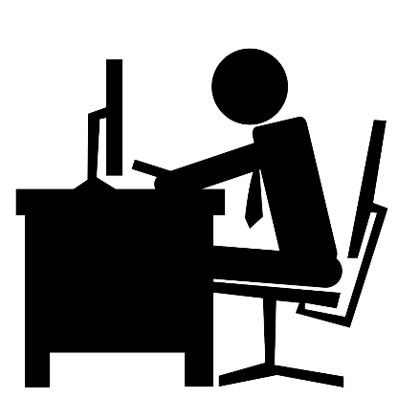
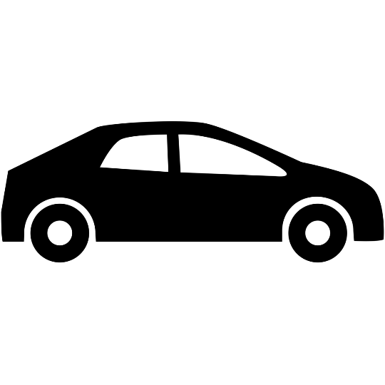
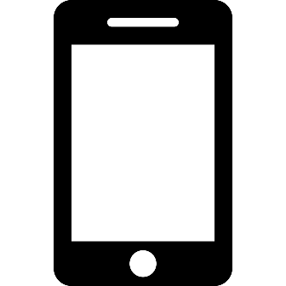
Good Credit

Slide 53
Good Credit

Slide 54
Financial Dependence
Have you ever stayed longer than you wanted in a relationship with someone who was controlling because of concerns about financially supporting yourself or your children?
73%
n = 1717
Adams & Littwin, in progress

Slide 55
Financial Dependence
Have you ever stayed longer than you wanted in a relationship with someone who was controlling because of concerns about financially supporting yourself or your children?
Women with coerced debt were 2.3 times more likely to stay longer due to financial concerns.
73%
Adams & Littwin, in progress

Slide 56
Financial Dependence
Were any of your concerns about money you owed because your partner put bills in your name or convinced you to borrow it?
Stayed longer because of financial concerns
41%
73%
Adams & Littwin, in progress

Slide 57
Financial Hardship
“We went through every damn dime I have, we’re done spending.”

Slide 58
Financial Hardship
“I think what this could have looked like had I not married him. And the possibilities of where I could be financially and where I am now. I’ve always done a lot of volunteer work in my life. I used to go down to the soup kitchen in downtown Detroit before I met him once a month and help make sandwiches and soup and serve the people and stuff, and never once did I ever think that may be my future.”

Slide 59
Financial Hardship
“[Before the relationship], it was a different kind of stress. It was managing my finances without too much debt. It may have been check-to-check, but it was check-to-check without heavy debt. [After], l was always stressed out. Always a mess. Constant anxiety. Having a hard time sleeping at night. Getting food from the food bank. Horrible hair cuts. Living like a low-income person. Struggling.”

Slide 60
U.S
Background
Defining Coerced Debt
Effects of Coerced Debt
Discussion

Slide 61
Discussion

